Slide 1

Autonomous Car
By: Ahmed Ashraf Mohamed

Slide 2



Agenda
Introduction
Components required
Design
Specification

Slide 3


Introduction
Developers of car nowadays looking how to make car smarter, safer, &easier so autonomous car made to drive itself and if it found any obstacle in front it take a decision weather to turn right or left or stop.

Slide 4

Components Required
Atmega-32
Buttons
LCD(LM016)
UltraSonic Sensor(HCSR04)
2Motors(DC)
Oscilloscope
Resistance
H-Bridge(L293D)
Servo Motor

Slide 5
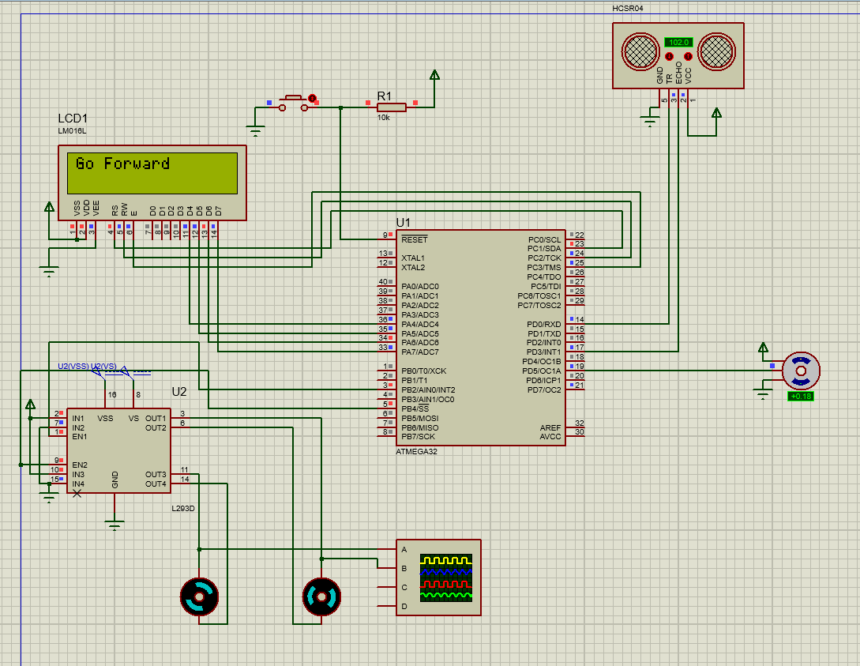
Schematic Design using proteus

Slide 6
Specifications
Ultra Sonic Sensing
Controlling the car

Slide 7
Ultra Sonic Sensing

Slide 8
Ultrasonic is used to detect any obstacles towards to the car
If the distance < 100 it start searching for empty place right and left
If it didn’t find any place the car will stop till the obstacle is removed and pressing reset button to start the operation again
the car must fast react to avoid this obstacle like stopping and turning to any empty direction.
Servo is used to make ultrasonic scanning around 180°.

Slide 9
Controlling the car

Slide 10
L293D is used to control the speed and the direction of motors.
LCD displays the current direction that car immediately move.
Car rotate right by disabling the right motor and keep other till it rotate 90 degree.
Car rotate left by disabling the left motor and keep other till it rotate 90 degree.
The two motors are controlled by signal from the controller.

Slide 11

Summary
Autonomous cars create and maintain a map of their surroundings based on a sensors situated in the vehicle and algorithm to decide when to move, rotate, & stop.

Slide 12
Thank You

